Slide 1

Module One:
Why the Classroom Diagnostic Tools?:
Building Background Knowledge
2013–2014
Tom Corbett, Governor
Carolyn Dumaresq, Ed. D
Acting Secretary of Education
Notes:
1
Notes for Trainer:
What’s in This Module?
Classroom Diagnostic Tools (CDT) Pre-Formative Assessment of Current Knowledge
CDT Connection to the Standards-Aligned System (SAS)
Types of Pennsylvania Assessments
Components of the CDT Cycle
CDT Connection to Response to Instruction & Intervention (RtII)
CDT Content Areas and Sample Map
Benefits of Using the CDT for Students, Educators, Parents, & Administrators
Responsibilities for Administrators
Identification of CDT Target Groups
In order to connect educator effectiveness with the CDT, slides specifying the four domains are included. Trainer should be knowledgeable about which elements connect to the CDT.
Various activities are embedded within the PowerPoint
Classroom Diagnostic Tools (CDT) Post-Formative Assessment of Current Knowledge
Using this Module
You are encouraged to customize any or all portions of this module to meet the needs of your audience. This module is intended to fit into a variety of different professional development settings. Any portion of this module may be modified, reproduced and disseminated without prior permission.
Suggested Module Delivery
Facilitate PowerPoint and activities that are embedded within the PowerPoint. Approximate time – 2 hours.
Facilitator Materials
Laptop to view module PowerPoint (iPad can only be used to access the PowerPoint and is not compatible to view the CDT maps).
Projection Unit
Go to eDIRECT site: https://pa.drcedirect.com. Click on Documents in the left side bar. Under Administration, select Classroom Diagnostic Tools 2013–2014. Under Document Type, dropdown to Professional Development. Find the following module: Why the Classroom Diagnostic Tools?: Building Background Knowledge PowerPoint.
Find the Graphic Organizer for Note taking, Module One
Print the following slides: 7, 10 (optional), 12, 29, 32, 35, 36 and 38.
On Slide 6 you will need to download Video 1 Tyler onto a jump drive for quick access. The video can be found under Documents in same area as the Modules. https://www.dropbox.com/s/13irl8ez56u3xmj/Student%20Video%20-%20Tyler.mov
Participant Materials
Laptop to view module PowerPoint (iPad can only be used to access the PowerPoint and is not compatible to view the CDT maps).
Each participant will need directions on how to access the PowerPoint.
Each participant will need a copy of the Graphic Organizer for Note Taking for Module One. Go to eDIRECT site: https://pa.drcedirect.com. Click on Documents in the left side bar. Under Administration, select Classroom Diagnostic Tools 2013–2014. Under Document Type, dropdown to Professional Development. Find the document titled Graphic Organizer for Note Taking, Module One: Why the Classroom Diagnostic Tools?: Building Background Knowledge
Print the following slides: 7, 10 (optional), 12, 29, 32, 35, 36 and 38.

Slide 2
What’s in this Module?
  CDT Connection to the Standards-Aligned System (SAS)
  Why we use the Diagnostic tool
  Features of the diagnostic reports
  CDT Content Areas and Sample Map
  Identification of CDT Target Groups
2
Notes:
Notes for Trainer:
Review.
Share where Module One and the Graphic Organizer for Notetaking is on eDIRECT. Go to https://pa.drcedirect.com
2

Slide 3
What are the Classroom Diagnostic Tools?
  The Pennsylvania Classroom Diagnostic Tools (CDT) are a set of online tools designed to provide diagnostic information in order to guide instruction and provide support to students and teachers. These tools (available at no cost to districts) are fully integrated and aligned with the Standards Aligned System (SAS) and will assist educators in identifying students’ academic strengths and areas of need, providing links to classroom resources.
3
Notes:
Notes for Trainer:
3

Slide 4
What are the Classroom Diagnostic Tools?
  The CDT is:
  Offered to students in grades 6 through high school. (Field test down to grade 3 in fall of 2013 and operational in spring of 2014.)
  Available for use in the classroom throughout the school year on a voluntary basis 3-5 times per year.
  Based on content assessed by the Keystone Exams and the Pennsylvania System of School Assessment (PSSA).
  Composed of multiple-choice items.
  Delivered as an online Computer Adaptive Test (CAT), ensuring valid and reliable measures of a student’s skills while minimizing testing time.
  Designed to provide real-time results for students and teachers with links to Materials and Resources in SAS.
4
Notes:
Notes for Trainer:
Stress the importance of CDT as an additional assessment that supports INSTRUCTION.
Students can spend as much time as needed to complete the CDT.
Possible teacher question, “How long does a CDT assessment take? There are 48–60 items per test, so time would depend on ability and attention level of the student.
If asked, “What is evidence of reliability and validity? “Results of this will come with outcomes of studies PDE plans to do.”
Teachers will be able to receive feedback in real time, so they can use it to inform instruction immediately, particularly feedback that is aimed directly at what kids should be able to know and do. Teachers then can make instructional adjustments and assess whether student responses correspond with the targeted learning progression.
Emphasize that the CDT provides a computerized tool that allows movement in Eligible Content below and beyond grade level for the individual student based on the results from the assessment.
4

Slide 5
Why should the Classroom Diagnostic Tools be used?
  Benefits for Students:
    Provides specific and timely feedback designed to support student learning
    Builds efficacy by bringing students into the process of their own learning
    Promotes goal setting by involving students in the learning process
    Provides students with opportunities to demonstrate their knowledge and skills
    Promotes partnering with educators (e.g., one-to-one conferencing)
    Ensures that follow-up instruction is meaningful and aligns with student learning expectations
5
Notes:
Notes for Trainer:
Based on how much time you have, you may want to have your participants brainstorm and write ideas on post-its and hang on large posters depicting Benefits for Students. Read and report out.
Or, if you are pressed for time, you want to use Random Reporter and have participants or tables read-aloud.
Deeper work on One-to-One Conferencing with students can be found in another module.
5

Slide 6
CDT Content Areas
Math
  Math Grades 6, 7, 8, Algebra I, Algebra II, Geometry
Literacy
  Reading Grades 6, 7, 8, Literature
  Writing Grades 6, 7, 8, Composition
Science
  Science Grades 6, 7, 8, High School
  Biology, Chemistry
6
Notes:
Notes for Trainer:
CDTs have been approved for grades 3, 4, and 5. The CDTs will be field tested the fall of 2013 and will become operational in the spring of 2014.
6

Slide 7
How often should the Classroom Diagnostic Tools be administered?
  Information about student strengths and areas of need over time enables educators to plan student instruction and provide appropriate follow-up activities to meet ongoing learning expectations. The CDT could be administered to students three to five times per school year based on student needs and analysis of data.
  The maximum number of administrations is five per CDT per school year.
  The recommended time between each administration is 5–6 weeks.
7
Notes:
Notes for Trainer:
Emphasize that administration of the CDT is a district/school/department/grade-level decision. It is not mandated by PDE, but it is highly recommended.
Stress that the CDT is for ALL students.
7

Slide 8
Each of the statements below is a characteristic of a Benchmark assessment (think 4 Sight or Study Island), a Diagnostic assessment (specifically the CDT) or both. Circle the appropriate answer.
DESCRIPTOR: | Benchmark | Diagnostic | Both
Results inform instructional practice | Benchmark | Diagnostic | Both
Grade/course-level specific | Benchmark | Diagnostic | Both
Administered throughout the school year | Benchmark | Diagnostic | Both
Gives information in regards to mastery of grade-level standards | Benchmark | Diagnostic | Both
Gives immediate results of student performance | Benchmark | Diagnostic | Both
Suggests instructional strategies that will help individual students | Benchmark | Diagnostic | Both
Answers the question “what”. What standards have the students achieved? What standards have not yet been met? | Benchmark | Diagnostic | Both
Answers the questions “what,” “why,” and “how”. What standards have the students achieved? How learning within a diagnostic category, based upon the Assessment Anchors and Eligible Content develops across grades. Why a student is achieving by breaking benchmarks across the learning progressions into fundamental skills and analyzing patterns of achievement across multiple measures. | Benchmark | Diagnostic | Both
Predicts success on the PSSA | Benchmark | Diagnostic | Both
Can be given up to (but not more than) 5 times per year | Benchmark | Diagnostic | Both
Results give a proficiency level | Benchmark | Diagnostic | Both
Students may be tested on material not formerly taught | Benchmark | Diagnostic | Both
A no cost assessment for PA LEAs | Benchmark | Diagnostic | Both
Supports differentiated instruction within RtII Tiers 1, 2, and 3 | Benchmark | Diagnostic | Both
Are quarterly formative assessments for grades 3 to 8. These assessments were created specifically to mirror the content and look of the PSSA. They are intended to provide a quick estimate of how students would perform on the PSSA if the state test were administered on the same day | Benchmark | Diagnostic | Both
8
Notes:
Notes for Trainer: These suggested answers are not the only discourse you will gain during this activity. The goal is for the participants to receive a clear understanding of the purpose of each type of assessment. As the training evolves, these answers will be further discussed.
Both - Benchmark and diagnostic assessments informs instructional practice.
Benchmark - A benchmark assessment is grade level specific.
Both – Both benchmark and diagnostic can be administered up to, but not more than 5 times per year. The recommendation for CDT is 3 times per year, but can be given up to 5 times per year. The maps for CDT will only show the three most recent assessments. The purpose is to provide enough intervention to support gains in the diagnostic category(s).
Benchmark - A benchmark assessment is grade level specific.
Both* - Diagnostic - Specifically the results for the Classroom Diagnostic Assessment can be accessed immediately after students take the CDT and Benchmark – only Study Island, as the results can be accessed immediately, but Not for 4 Sight. The Open-ended for 4 Sight needs to be hand scored, so reports cannot be run immediately.
Diagnostic - The CDT suggests specific eligible content as instructional enrichment that is linked to SAS Materials and Resources. The Instructional Enrichment can also be accessed from the materials and resources of the professionals in the school/district.
Benchmark - Benchmark is grade level and grade standards specific assessment tool.
Diagnostic - specifically the Classroom Diagnostic Tools
Benchmark - specifically the 4 Sight
Both – For both assessments, this is generally a school, content, or individual teacher decision under the leadership of the building principal.
Benchmark - specifically the 4 Sight
Both - Although a benchmark is grade level specific, the students may not have been taught what has been assessed on the Benchmark. Likewise, the CDT may provide students assessments that were not formerly taught because of gaps in instruction, student mobility, or questions that are beyond their grade/course.
Diagnostic - specifically the Classroom Diagnostic Tools. This tool has been budgeted through the Pennsylvania Department of Education for use by PA teachers for PA students.
Both - Diagnostic and benchmark support DI within an RtII framework. Many teachers use benchmark information to differentiate within Tier 1, and depending on what Tiers 2 and 3 look like, they may utilize benchmark information as well to determine which grade/course level skills need intervention/remediation.
Benchmark

Slide 9

What are the similarities and differences between Benchmark Assessments and Diagnostic Tools?
Diagnostic
Benchmark
Grade-level specific
Diagnosis of student strengths and areas of need at instructional level
Measures content at the reporting category level for reading and math
Results support goal setting
Results need to be used
Answers the questions, What? Why? and How?
Can be given no more than five times a year
Provides a standards-aligned benchmark
Share with parents
Provides current level of performance
Students do not receive direct, formative feedback
Informs instructional process
Provide effective feedback
Forces us to ask more questions
Identifies areas of strengths and needs across grade levels and subject areas
Answers the question, What?
Process of regularly collecting, summarizing, and analyzing information to guide development, implementation, and evaluation of instruction
Individual/small group measurement tool
Class tool
Most lessons to support eligible content for strengths and areas of need are available on SAS
Provides an estimate of student performance on a summative assessment
Students may be tested on material not formerly taught
Results may be used to establish student goal setting
Fixed form–everyone takes the same assessment at a given grade level
Computer-adaptive tool based on a vertical scale that spans content from grades 3 to high school/course
Administered throughout the school year
Supports differentiated instruction within RtII Tiers 1, 2 and 3.
Group measurement
Summary report
9
Notes:
Notes for Trainer:
Validate audience’s responses with this slide. The audience may easily create more ideas than listed. Again, this slide is to generate discussion. Always keep in mind the question, “What is the purpose of the assessment?”
9

Slide 10
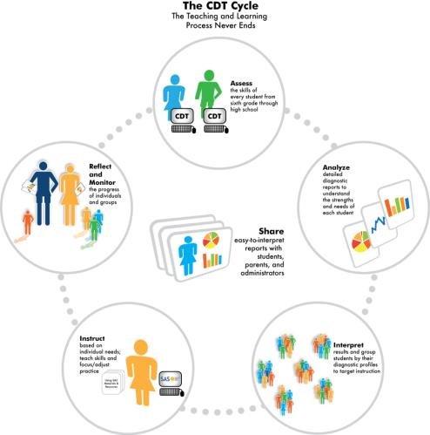
CDT Assessment Cycle
10
Notes:
Notes for Trainer:
This icon supports the CDT Cycle. The process of teaching and learning never ends. It is not just the student and the educator, but the involvement of both.
Solicit using Random Reporter to read off the bold of each area as a clock: Noon, 3:00, 5:00, 7:00 and 9:00. After the participant reads the bolded word(s), respond with the words in lighter font. Then, point out the center – the critical component of the CDT Cycle.
Let the audience know a wealth of research supports all areas, and then connect the Share with the Reflect and Monitor that actively supports student achievement.
The module on one-to-one conferencing with feedback will go deeper with the research to support the importance of SHARE with Reflect and Monitor.
10

Slide 11
Reports and What they Mean?
*Reports provide a snapshot of how students are performing in relation to the Pennsylvania Assessment Anchors & Eligible Content and Keystone Assessment Anchors & Eligible Content.
*The diagnostic reports link to targeted curricular resources and materials, including units and lesson plans found within the SAS system.
11
Notes:
Notes for Trainer:
11

Slide 12
How are Scale Scores Derived?
Students’ scores are converted into scale scores rather than points correct or raw scores
Scale scores are transformed raw scores that allow for valid comparisons across students, grades, and administrations, but only within the same subject
Scales scores take into consideration the fact that some questions on the test are more difficult than others
CDT Minimum scale score of 400
CDT Maximum scale score of 2000
Note: Item Response Theory (IRT), specifically the Rasch model, is used to determine the student’s raw score
12
Notes:
Notes for Trainer:
The minimum scale score is 400, and the maximum scale score is 2000 for all CDT assessments. Scale scores allow for multiple variables, like item difficulty, to be factored into the student’s results.
Item difficulty rather than raw score (number correct) is a critical component of administering an adaptive classroom diagnostic tool.
As a reminder, Scaled Scores do not predict proficiency on the PSSA.
12

Slide 13
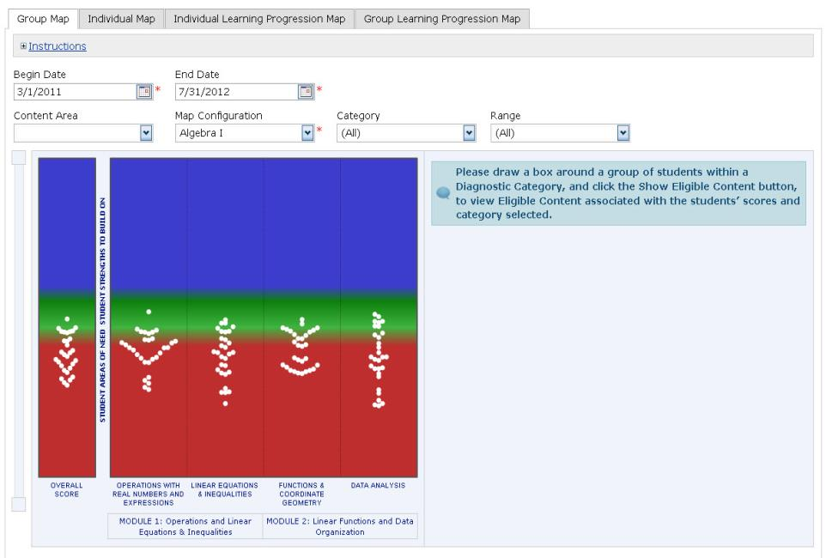
Red= Areas of Need
Green/Blue=Student Strengths to Build
13
Notes:
Notes for Trainer:
The four tabs that comprise the CDT map include: Group Map, Individual Map, Individual Learning Progression Map, and the Group Learning Progression Map.
Deeper work will be provided in other CDT Modules.
13

Slide 14
Defining the Tabs
Group Map- Illustrates the entire class results. Each student is represented by a white dot.
Individual Map- Shows a specific student’s results on the assessment.
Individual/Group Learning Progression Map- Breaks down the specific eligible content that students demonstrate equal to or better than expected performance, or performance on Eligible Content that was less than expected performance.
14
Notes:
14

Slide 15
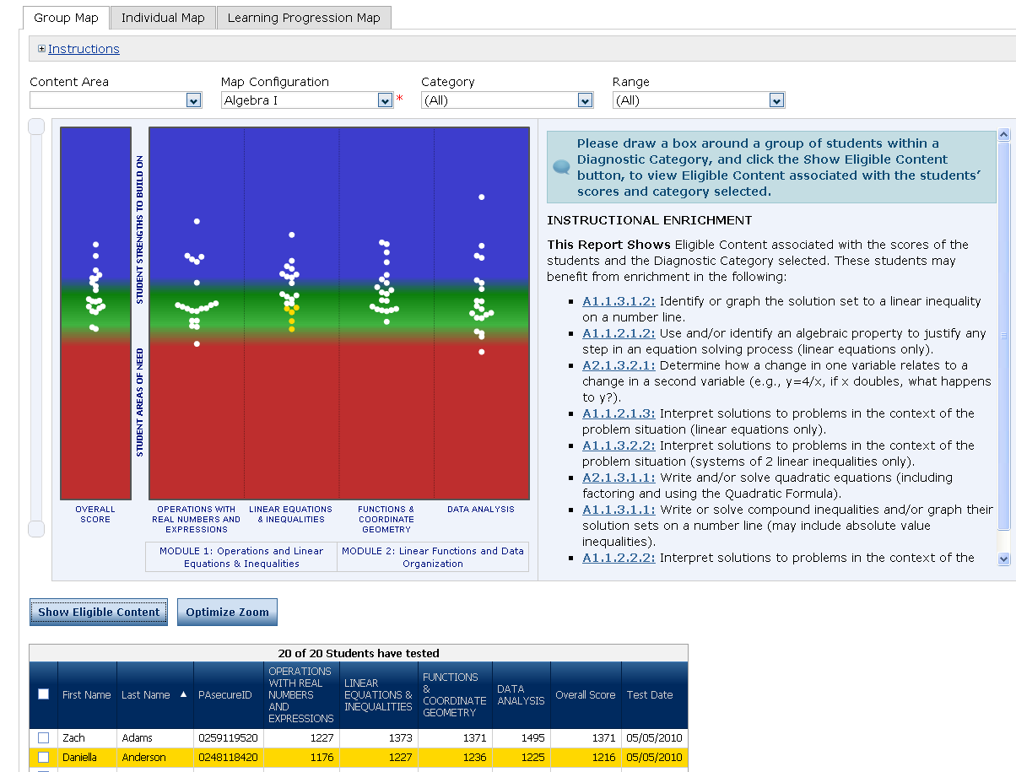
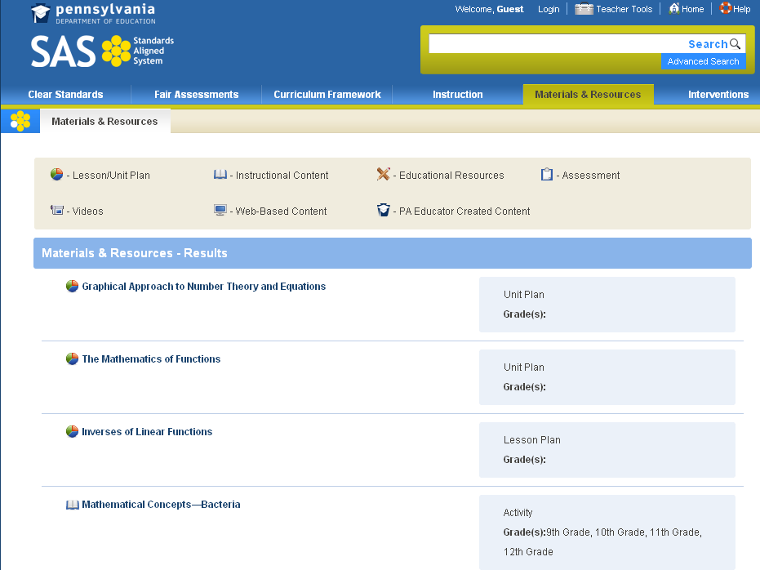
Group Diagnostic Map – Algebra I
Notes:
THESE ARE COVERED IN THE LIVE DEMO. IF YOU HAVE INTERNET CONNECTION PROBLEMS, THEN YOU WILL NEED TO USE SLIDES 10-25. During the presentation, you can cover the following:
Use the tabs along the top to navigate through the different reports
Discuss the Map itself
Dots represent students.
Users can hover over a dot to display student identifying information as well as score.
Colors represent the scale continuum.
There is a total score column and columns for each diagnostic category.
Diagnostic categories for the Keystone subjects (Algebra I, Algebra II, Geometry) are divided into two modules.
Users can click on a dot to show a student’s performance across all the diagnostic categories. (A black line will appear.)
Users can select several students by drawing a box around them on the map.
User can click on Show Eligible Content button to display information along the right side of the report under Instructional Strategies.
Eligible Content (EC) will display. These are areas in which the student(s) could benefit from further enrichment.
The EC numbers themselves are links to Materials and Resources within the SAS system.
Note to Trainer: some Eligible Contents demonstrated as strengths or needs have been pre-populated to lessons or web-based activities on SAS. For many Eligible Contents showing strengths or needs, there are no lessons pre-populated on SAS at this time. Many lessons are continually being evaluated for placement on the SAS site attributed to strengths and needs of the Eligible Content. Lessons are continually being developed thanks to our teachers. If no lessons are posted at this time, the teacher still knows the areas of strengths and needs and is able to construct lessons from his/her specially designed lessons or those found within his/her curriculum or textbook.
The grid at the bottom of the map shows students in the group along with their scores in a tabular format.
Users can click on the Export All to CSV button to export the data in the grid to a CSV file, which can be easily opened in Excel.
Users click on Export to PDF to export the image of the map along with the grid and any Eligible Content that is displayed to a PDF file.

Slide 16
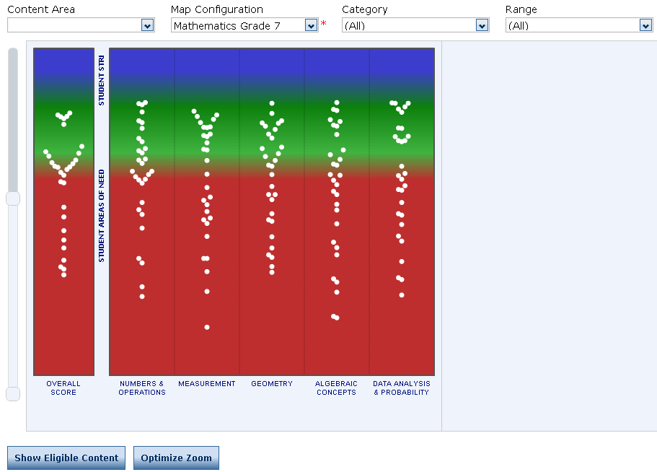
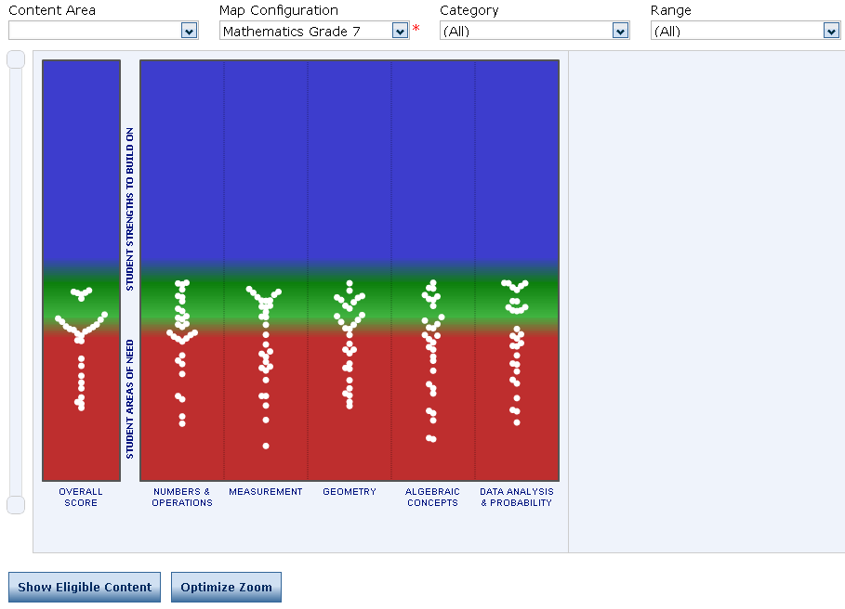
Group Diagnostic Map – Mathematics
Zoomed In Zoomed Out
Notes:
Notes for Trainer:
During the presentation, you can cover the following:
The default view for the map is zoomed all the way out, so the slider bars on the side are set out as far as they can go.
Click on the Optimize Zoom button, so the maps zooms into the area of the scale where the students are listed. (The student with the highest score will appear towards the top; the student with the lowest score will appear towards the bottom.)
Users can use the slider bar along the left side to adjust the view.
If you expand the slider bar to the full view (square buttons at top and bottom are pushed apart as far as they go), the full scale will display.
You can adjust both top and bottom buttons to display only students within a given range.
The range of the CDT goes from 400 to 2000, regardless of grade.
3. Use this slide to discuss changing the map configuration.
You can see how the students in the group performed compared to the benchmark at a different grade.
In the filter area, go to Map Configuration.
Select a different grade to see how the map re-paints.

Slide 17
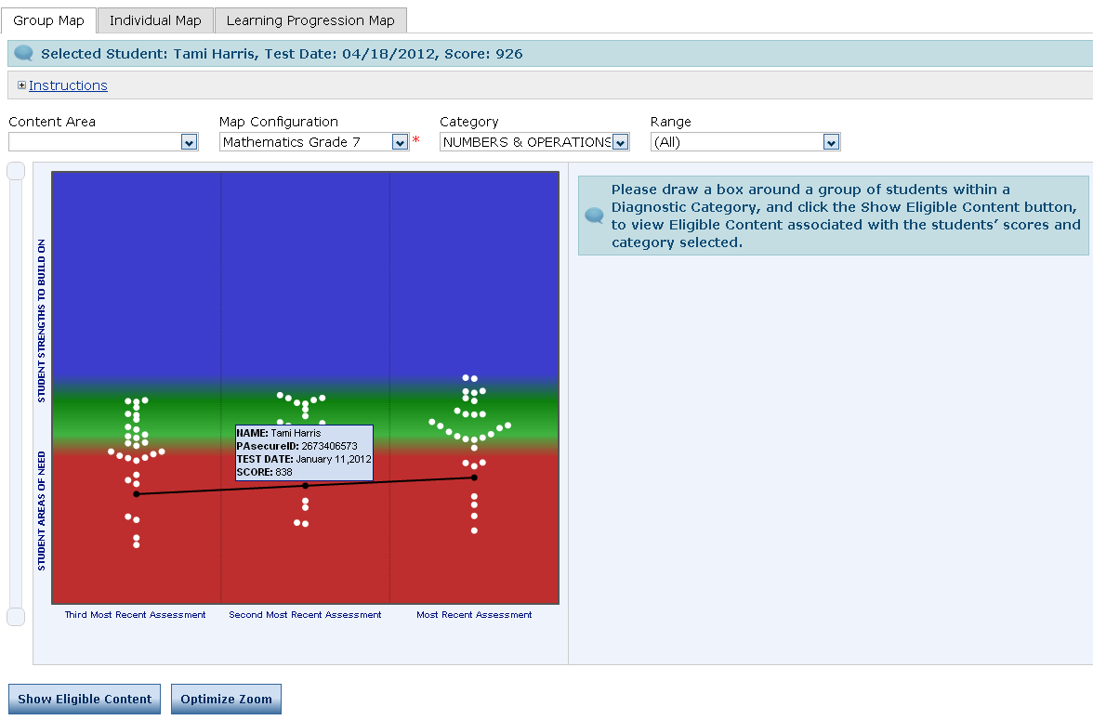
Group Diagnostic Map
Single Diagnostic Category
Notes:
Notes for Trainer:
During the presentation, you can cover the following:
At the top of the group diagnostic map, you can choose to see a single diagnostic category.
When a single diagnostic category is chosen, results for the past three assessments will display.
This screen shot displays the student-level information that is displayed when hovering over a dot.

Slide 18
Learning Progressions
What are Learning Progressions?
  Learning Progressions show the developmental sequences or building blocks of content/skills students need to master as they progress toward career and college readiness.
  The progressions are tied directly to the Assessment Anchors and Eligible Content.
  The progressions are also tied directly to the Voluntary Model Curriculum (VMC) Units and Lesson Plans and are posted on the SAS Website.
Notes:
Notes for Trainer:
One of the major benefits of the CDT is its direct link to Learning Progressions. Before looking at the reports that are tied to Learning Progressions, it is important to understand what Learning Progressions are and why they are important.
Note to Trainer: the purpose for this slide and the next slide is not to provide in-depth training on Learning Progressions; rather, the purpose is to provide a brief introduction to Learning Progressions so that the CDT report and the Learning Progression Map will be more easily understood.

Slide 19
CDT Learning Progression Map
The CDT includes a report tied directly to Learning Progressions.
This report:
  provides a scrollable vertical map showing how a student’s learning progresses for each diagnostic category across grades and/or courses.
  helps teachers plan targeted instruction by providing a visual snapshot of how the student is progressing.
  includes information as to whether the student is
    still struggling to master foundational content and/or
    moving forward with more advanced content.
Notes:
Notes to Trainer:
The purpose of this slide is to introduce the CDT report tied to the Learning Progression Map. It provides an overview of the benefits of the report.

Slide 20
CDT Learning Progression Map
This report also
  shows exactly which Assessment Anchors and Eligible Content is measured by each CDT item or items the student answered correctly or incorrectly.
  provides a sample item of average difficulty for each Assessment Anchor as defined by the Eligible Content.
  provides teachers with the most efficient and direct way to find units and lesson plans in SAS directly tied to Eligible Content.
  links directly to additional materials and resources in SAS.
Notes:
Note to Trainer:
This slide continues to point out some of the benefits of the CDT report tied to the Learning Progression Map. You may want to emphasize that the report provides teachers with the most direct and efficient way to access the SAS units and lesson plans tied directly to Eligible Content. It is the only place where teachers can access sample items prepopulated from SAS.

